Slide 1
Instructions for this PowerPoint Deck
NOTE: FIRST SAVE THIS FILE TO YOUR LOCAL DIRECTORY
Once saved to your local directory, delete the example slides and magenta notes/tips from this template. A variety of layouts are accessible through the layout dropdown in the Home menu.
To paste content from another slide deck, copy slide from the original file, bring to this file – then right-click and select the option for “paste using destination theme.” Then, on the Home ribbon, click Layout or Reset. You will then need to fix any formatting issues.
Font should be Arial throughout.
After creating a slide select a format for your slide on the Home ribbon, click the dropdown for Layout and select from one of the options. Several options are also available in the slide thumbnails displayed on the left. Please delete the slides you do not wish to use.
To add slides, go to the “Home” ribbon above and choose a slide option from the “New Slide” pulldown. Learn more about adding slides here.
Photos can be changed by clicking on the image, then going to the “Picture Format” ribbon above and selecting “Change Picture” pulldown. Learn more about replacing a picture here.
For assistance with photography, your CoEC MarCom team can help provide access/options. Please send a Communications Request Form.
Any text, image, or icon that you place in a deck can be turned into a hyperlink. Learn more here.
To add or remove page numbers from the deck, go to the “Insert” ribbon and then to “Slide Number.”
All slides have text prompts and image placeholders that can be copied and pasted to other pages, moved, or deleted. This flexibility enables you to create a deck that best suits your content. But please keep all Drexel brand colors, Dragon icons, University wordmarks, and other brand indicators in place to maintain continuity and a “One University” appearance with other decks throughout the University.
PowerPoint can be a little tricky to manage at first, but Microsoft has a vast array of tutorials and help options online at https://support.microsoft.com/en-us/powerpoint

Slide 2
Example Title PPT Deck
Left Bar Template (in Layout Dropdown)

Slide 3
Content Slide Example
This following slides are layout examples. To see your options, click on the Layout dropdown on the Home ribbon.
Example content slide
  Insert your content here
  If pasting, be sure to right click and use “destination theme”
  Font should be Arial throughout, check your formatting!

Slide 4
Left Bar layout
The Drexel Difference
Academics
Experience
Outcomes
Student center education rooted in developing lifelong success
Future-focused academic programs designed with expertise from industry leaders
Flexibility and interdisciplinary exploration
Deep support system and resources
Unmatched experiential learning opportunities
Career-ready skills
Deep Satisfaction
Lifetime earnings
Notes:
What makes Drexel different???
Quite simple- but unique
World-class academics + Unparalled experiences leading to undeniable outcomes
Student center education rooted in developing lifelong success
Career-Ready Skills.
Students will progress through mastery of the core competencies and gain practical, lifelong skills taught through the lens of different disciplines, encouraging the pursuit of opportunity, the following one’s passions,
All-new curricula and classes: As Drexel has always dome, the programs are Future- focused and -forward thinking designed with insight from industry leaders.
• Flexible, interdisciplinary study: This integration will help students explore interests across fields, double major with ease, and leave with a degree that reflects your unique interests and career goals – which mirrors the demands of the next generation workplace.
• Expand the definition of experiential learning: A catalog of opportunities Starting with an engaging Introduction to Experiential Learning Course, students will have access to a robust catalog of opportunities like global experiences, research, community engagement, practicum, curricula-based ELOs and more, in addition to the foundational work experiences gained from co-op.
• From advising to program management to research: students will have a deeper bench of cross-disciplinary support.
Experience- we are global leaders in experiential learning and these opportunites will allow you to put the theory you learn in courses into real world practice
Taken together, this leads to undeniable outcomes

Slide 5
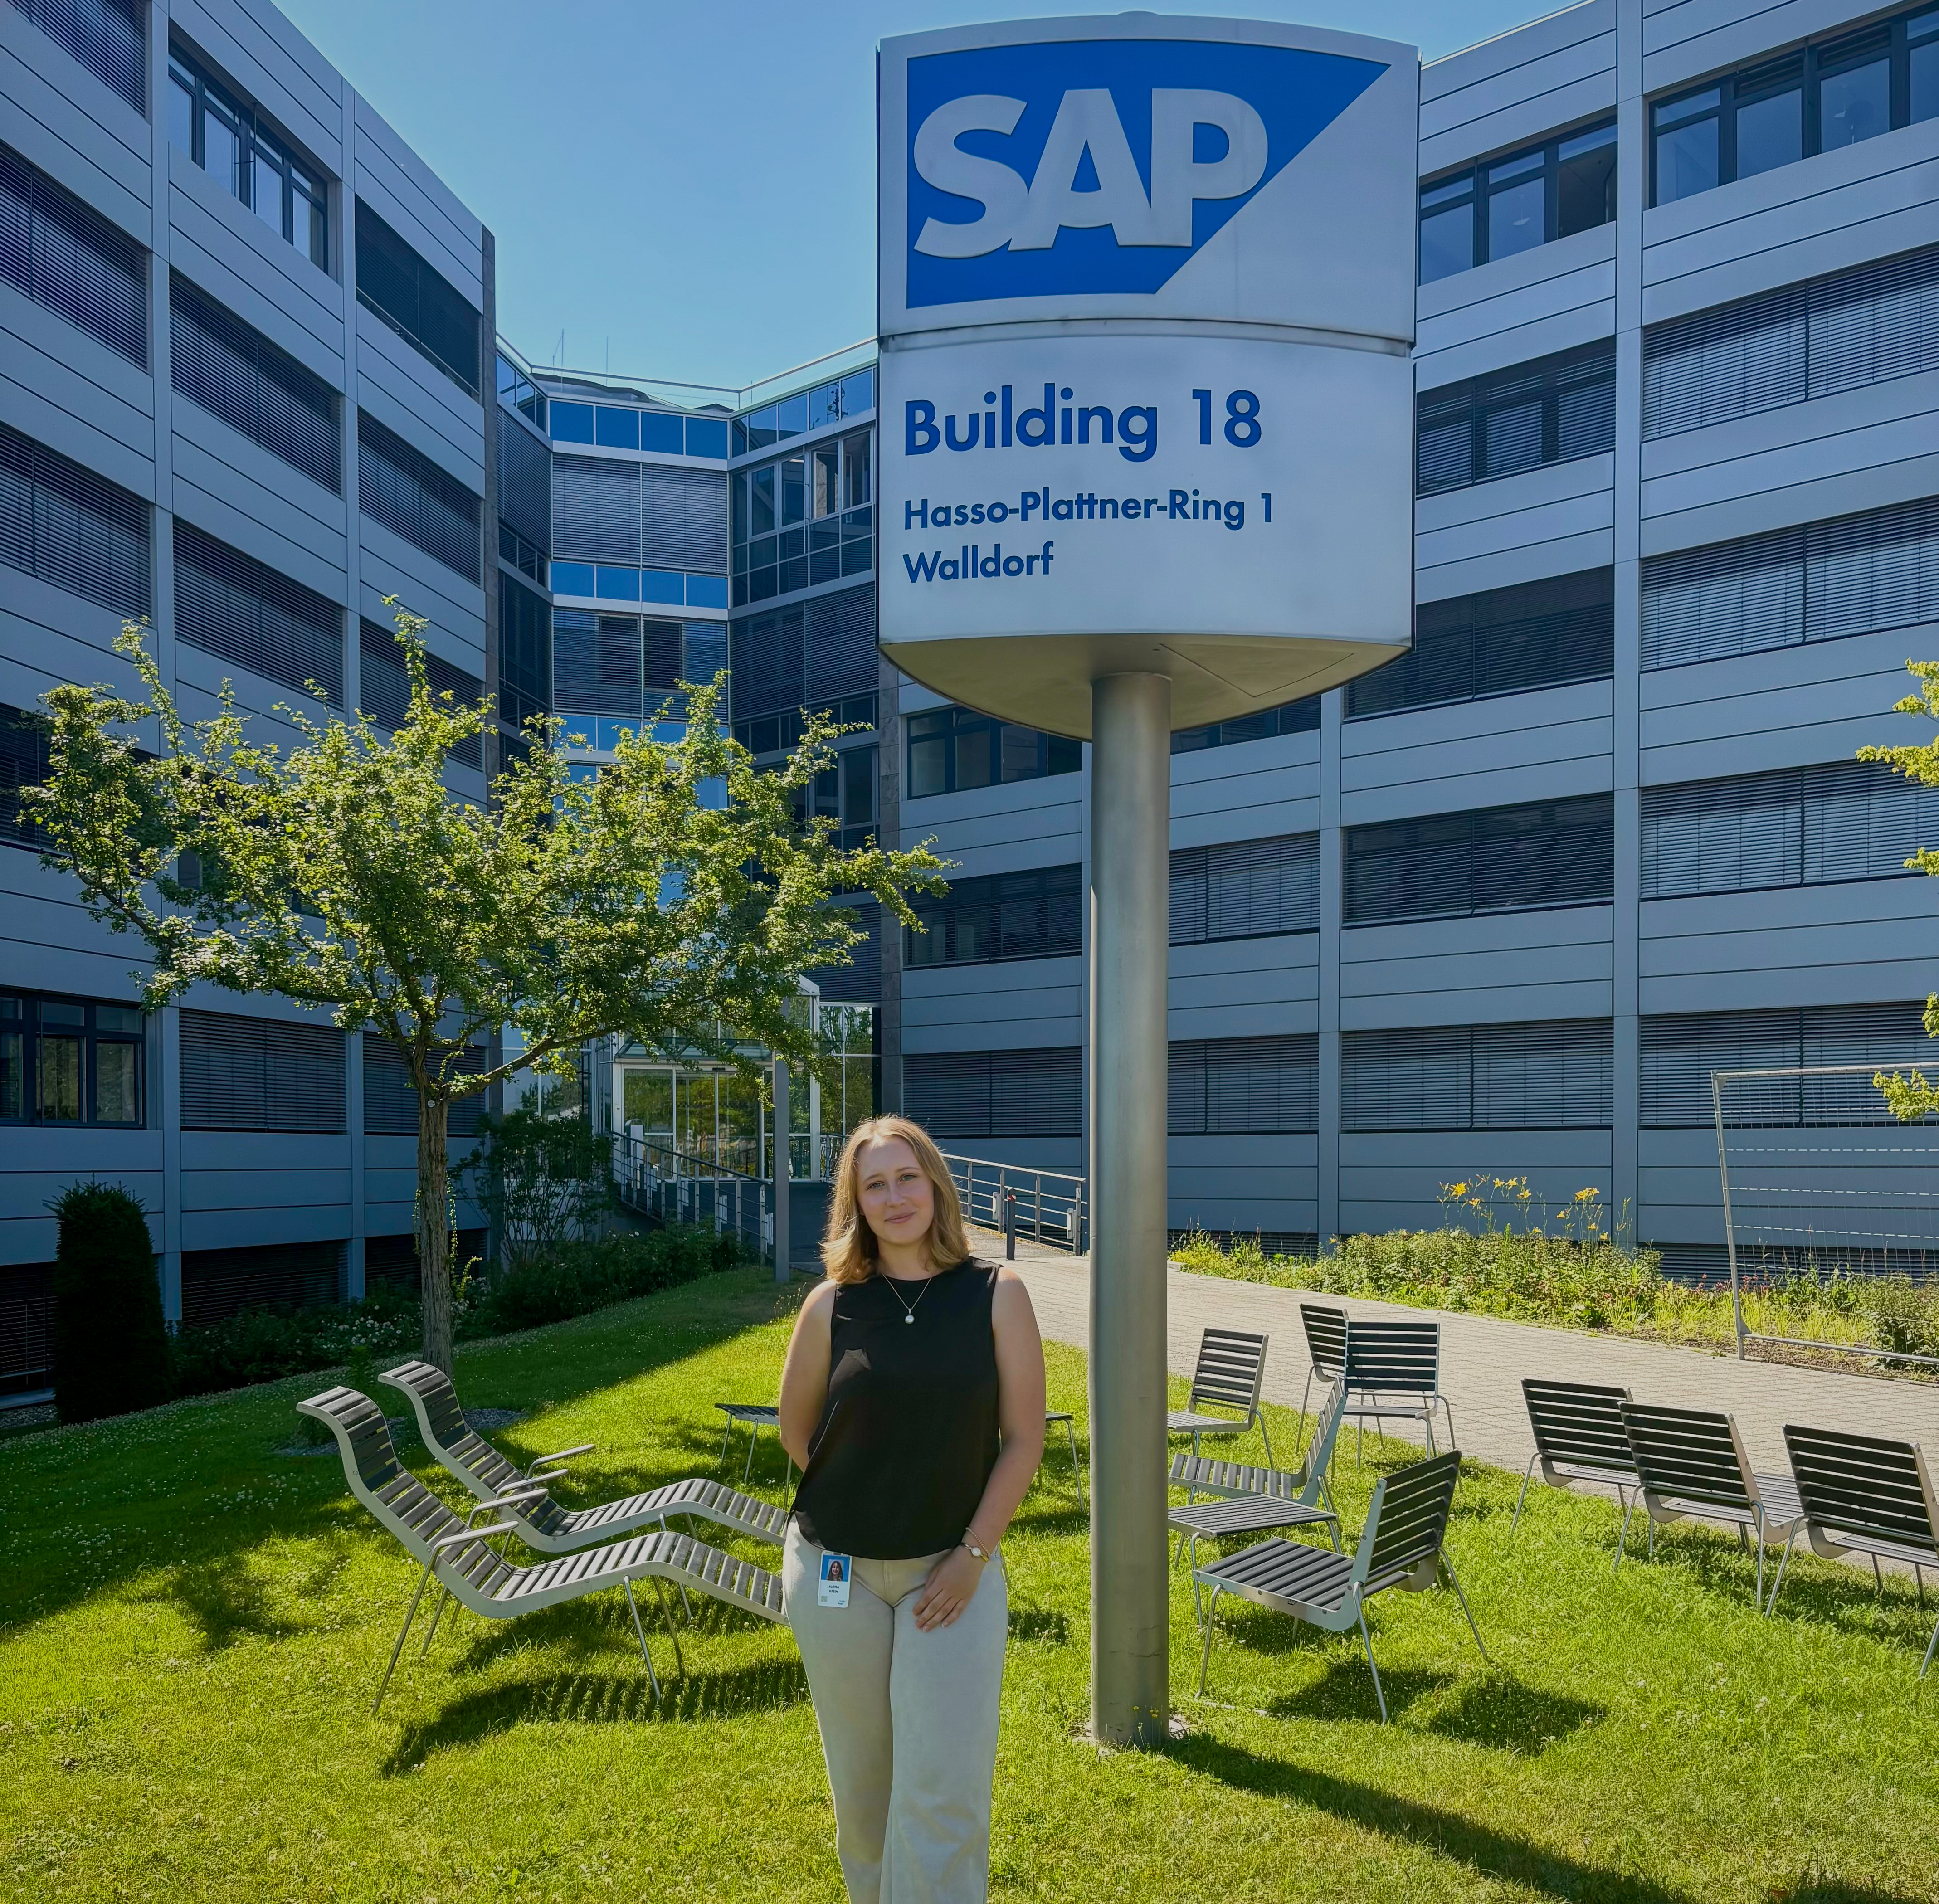
Experiential Learning
Use indents/tab to style the bullets properly (instead of the bullet button)
  Make sure your bullets are all styled the same throughout
  Less is more- minimize text and use visuals!
Notes:
Curricular and non-curricular activities

Slide 6
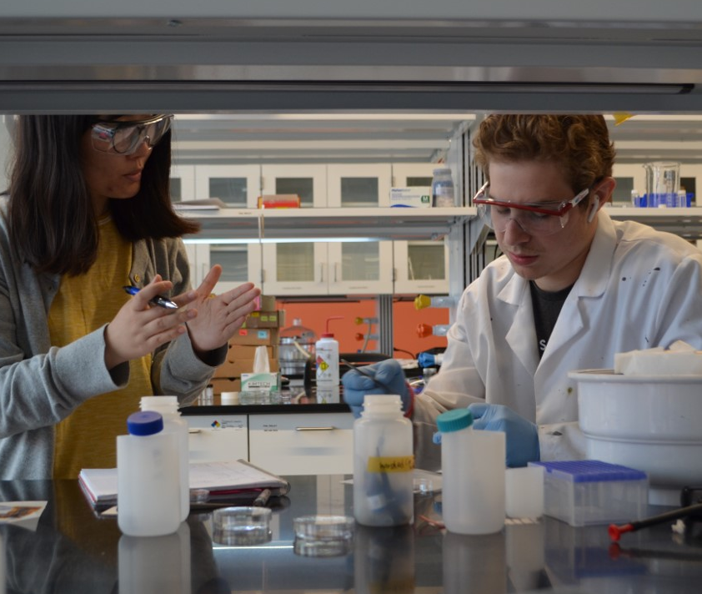
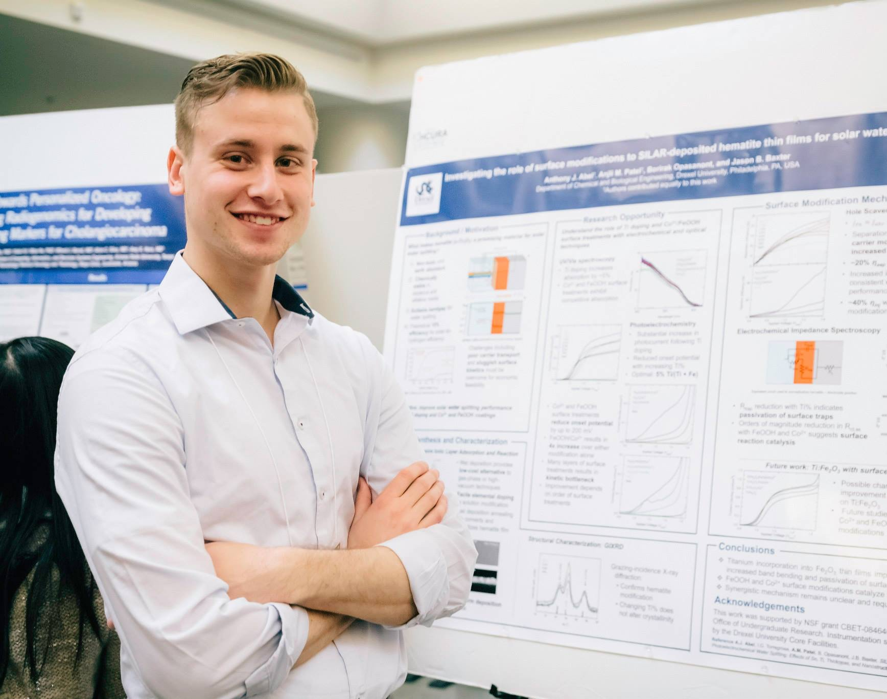
Student Research Experience
STAR -Students Tackling Advanced Research
  An opportunity for first-year students to participate in faculty-mentored research during the summer after first year.
VIP- Vertically Integrated Projects Program
  Multidisciplinary: drawing students from all disciplines on campus
  Vertically-integrated: mix of students— freshman through PhD each term (often starting with STAR)
  Long-term – undergraduate students may participate in a project for up to three years
Other opportunities to get research experience
Notes:
There are several ways that you can get involved in undergraduate research,
Research offers students to dive deep into a field, almost always project and team based and often involving students at a variety of levels and directly with faculty.
STAR, Students Tackling Advance Research, Scholars Program.
This program provides an opportunity for students, through an application process to get paid and have a full-time placement in a research laboratory in the summer after their first year with mentorship by faculty and graduate students.
Some students use this as a way to firm up their selection of studies since they'll know what kind of research and development is happening in the areas that they've chosen for their majors.
The STAR Scholars Program allows for students at the end of their summer experience to get some practical experience. There is a poster presentation symposium which is a great event for the Drexel community and external visitors.
Another program that you can get involved in throughout your time at Drexel is our new Vertically Integrated Projects (VIP) Program.
This is a program that allows the students within all disciplines and across all different years to work together on long term projects.
The idea is that we try to incentivize the students to oversee projects through their entire lifecycle from initial design to maintenance of prototypes.
By working on these projects for extended periods of time, students will be mentored when they do first start the program, but by the end of the program will learn and be able to mentor the others coming up behind you.
Although not a comprehensive list, these are some of the projects from the program.
Measuring air quality with kite-based sensors
Miniature brain implants and surgical tools
Cognitive neuro-engineering for the brain and mental flexibility
Integrated simulation-experimentation-analysis approach to advanced manufacturing
IoT framework to link material & structural diagnostics with prognostics

Slide 7
Template 2 Title Option
Top Bar Template with several title slide formaats

Slide 8





Notes:
Solving complex and interconnected global challenges—like climate change, pandemics, and technological disruption—requires the integration of diverse fields, perspectives, and skills, interdisciplinary thinking becomes essential.
To meet this moment, Drexel is launching the College of Engineering and Computing—an integrated academic unit built on pillars of strength in engineering, computing, and biomedical innovation—to prepare students to lead across disciplines and seize the opportunities of a rapidly evolving world.
Currently three separate units by the time you enter we will be one integrated unit, leveraging all the makes a drexel education incredible

Slide 9


"i know the world is going to change, and therefore, the university must change with it.“
Anthony J. Drexel, Founder
This is an example. To replace image, right click

Slide 10
Section Divider Option
Right click on photo to change background

Slide 11
Student center education rooted in developing lifelong success
Top Bar layout
THE DREXEL DIFFERENCE
Academics
Experience
Outcomes
Future-focused academic programs designed with expertise from industry leaders
Flexibility and interdisciplinary exploration
Deep support system and resources
Unmatched experiential learning opportunities
Career-ready skills
Deep Satisfaction
Lifetime earnings
Notes:
What makes Drexel different???
Quite simple- but unique
World-class academics + Unparalled experiences leading to undeniable outcomes
Student center education rooted in developing lifelong success
Career-Ready Skills.
Students will progress through mastery of the core competencies and gain practical, lifelong skills taught through the lens of different disciplines, encouraging the pursuit of opportunity, the following one’s passions,
All-new curricula and classes: As Drexel has always dome, the programs are Future- focused and -forward thinking designed with insight from industry leaders.
• Flexible, interdisciplinary study: This integration will help students explore interests across fields, double major with ease, and leave with a degree that reflects your unique interests and career goals – which mirrors the demands of the next generation workplace.
• Expand the definition of experiential learning: A catalog of opportunities Starting with an engaging Introduction to Experiential Learning Course, students will have access to a robust catalog of opportunities like global experiences, research, community engagement, practicum, curricula-based ELOs and more, in addition to the foundational work experiences gained from co-op.
• From advising to program management to research: students will have a deeper bench of cross-disciplinary support.
Experience- we are global leaders in experiential learning and these opportunites will allow you to put the theory you learn in courses into real world practice
Taken together, this leads to undeniable outcomes

Slide 12
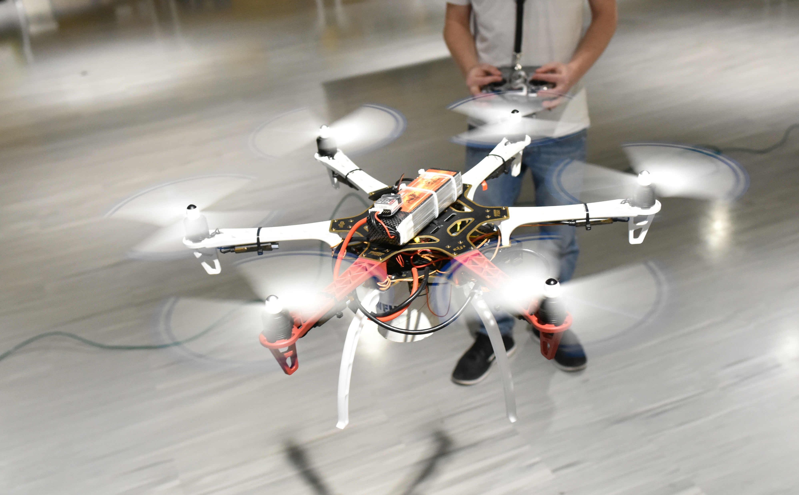
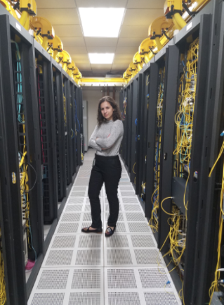
Modify as needed, but be sure to follow the template theme and keep fonts and styles the same. The yellow bar with the headline can be adjusted for the height of the text – do not change the width.
College of Engineering & Computing
Undergraduate Majors By Theme
Computing and Electronic Systems
  Computer Engineering
  Computer Science
  Computing & Security Technology
  Electrical Engineering
  Software Engineering
Intelligent Systems and Analytics
  Artificial Intelligence & Machine Learning
  Data Science
  Economics and Data Science
Health and Human Systems
  Biomedical Engineering
Infrastructure, Environment, and the Built World
  Architectural Engineering
  Civil Engineering
  Construction Management
  Environmental Engineering
Materials, Manufacturing, and Energy Systems
  Chemical Engineering
  Engineering Technology
  Materials Science and Engineering
  Mechanical Engineering
Exploratory Pathways
  Undeclared Engineering
Double majors and minor options available, including an undergraduate minor in Robotics and Automation
Numerous accelerated degrees programs (e.g. BS/MS, BS/MD, BS/JD)

Slide 13
Experiential Learning
Co-op and intern experiences
Global education
Undergraduate research
Civic engagement
Project-based learning
Student clubs/organizations
Varsity and intramural athletics
Notes:
Curricular and non-curricular activities

Slide 14

Cooperative Education (Co-op)
Capitalize on over one hundred years of co-op, starting with engineering students in 1919
Explore a potential career with over 1,600 companies in our database
Network with industry professionals
Create a standout resumé and refine interview skills
Learn about career interests and direction

Slide 15
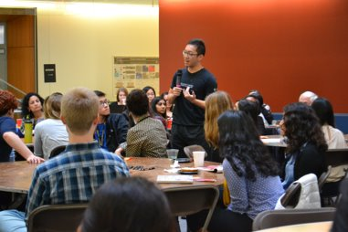
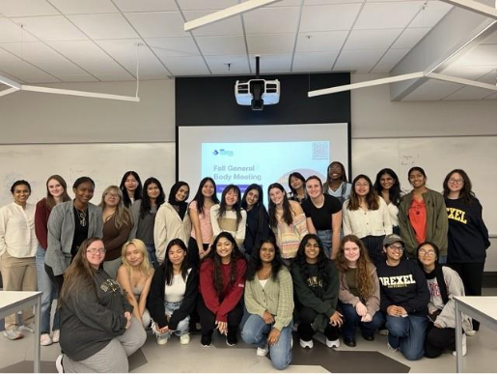
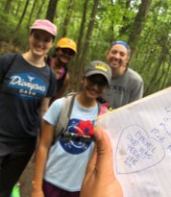

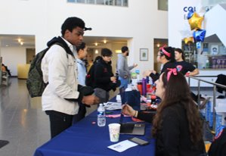
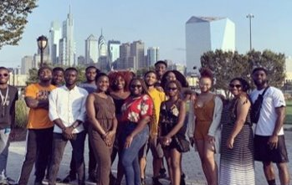
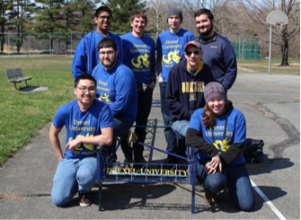
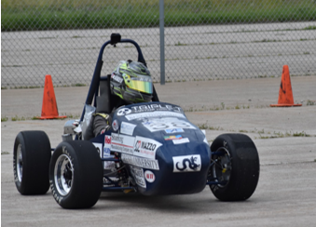
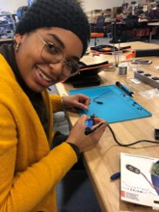
Student Organizations
Alignment and spacing helps keep it clean when including many elements
Notes:
With more than 30 student organizations—from electric racing and robotics to environmental engineering and computing for social good—Drexel offers a vibrant, diverse community where students can explore their passions, build leadership skills, and connect across disciplines.
Dozens more organizations across the university

Slide 16
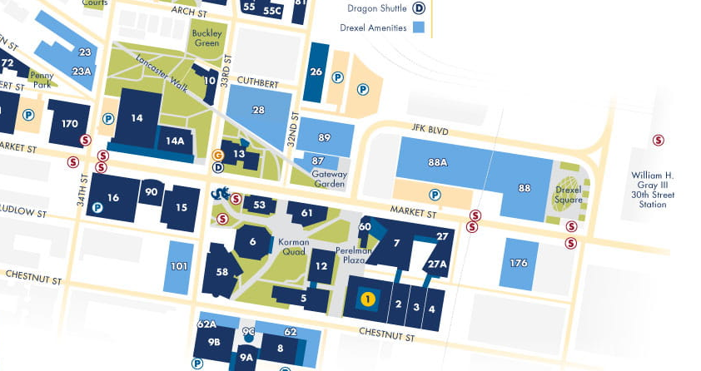
Information Session Locations
Use the No Logo layout if image takes up the entire slide

